Slide 1
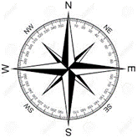
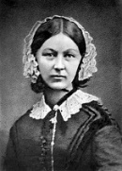
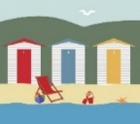
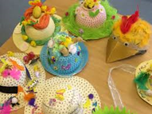
Autumn 2/Période 2
English texts: Explanation writing; Traditional Tales
History: Great Fire of London
Geography: Fieldwork, familiar spaces
Science: Personal Hygiene, classifying living & non-living
PSHE/EMC: Self esteem; care for property
RE: Rights of passage – birth ceremonies
Spring 1/Période 3
English texts: Stories by Roald Dahl
History: Florence Nightingale, Mary Seacole, Louis Pateur: why are they remembered today?
Geography: UK & France – countries & capital cities
Science: Solids & liquids
PSHE/EMC: Equality & difference, looking after each other, Internet Safety
RE: The Trust Game
Trip: Florence Nightingale visit and
French Institute
Autumn 1/Période 1
English texts: Poetry, non-chronological reports and The Diary of a Killer Cat
History: Measuring time (days, weeks)
Geography: Position & Direction
Science: Animal varieties
PSHE/EMC: Rules; emotions
DT: Junk modelling
Trip: London walk
2B*/CPB**
*taught in English **taught in French
Spring 2/Période 4
English texts: Animal stories
History: Measuring time (months, years)
Geography: Movement
Science: Living things in their environment; simple food chains
PSHE/EMC: People who help us
DT: Making hats
Spring Hat Parade
Summer 2/Période 6
English texts: Animal information texts and acrostic poems
History: How have seaside holidays changed?
Geography: comparing lifestyles & cultures
Science: Exercise & diet
PSHE/EMC: Changes; SRE; disability
RE: What are we grateful for?
Summer 1/Période 5
English texts: Charlie and the Chocolate Factory & stories from Anthony Browne
History: Clothing over time
Geography: Basic human/community features
Science: Air
DT: Making windmills
PSHE/EMC: Waste, community care
RE: Ramadan & Buildings in Worship
Trip: V&A Museum

