Slide 1
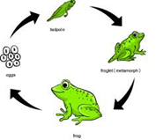
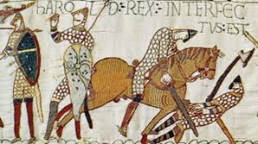
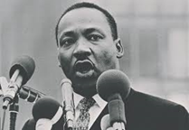
Autumn 2/Période 2
English Text: Tale of Two Beasts, The Iron Man
History: Stone Age to Iron Age
Geography: local area & stakeholders
Science: Bodily movement – skeletons & muscles
RE: Hinduism
PSHE/EMC: Bullying & self esteem
Spring 1/Période 3
English Text: The Lion the Witch and the Wardrobe and Poetry
History: Ancient times
Geography: Role of community stakeholders
Science: Digestive System & Nutrition
RE: Secularism
PSHE/EMC: Internet Safety
Visit: George
the Story Teller
Autumn 1/Période 1
English Text: Leon and the Place Between
History: Comparing, estimating, measuring time (Minutes, seconds, millenium)
Geography: Cartography work - Naming & locating countries, continents, oceans
Science: Life cycle of animals; different types of birth; classification
PSHE/EMC: Rights & duties
4B*/CE1B**
*taught in English **taught in French
Spring 2/Période 4
English Text: The Story Thief
History: Viking invasions
Geography: Earth as part of universe
Science: States of Water
PSHE/EMC: What is a moral dilemma?
RE: Sikhism
Summer 2/Période 6
English Text: Shackleton’s Journey
History: Battle of Hastings
Geography: Terrains and their impact on lives
Science: The Water Cycle
PSHE/EMC: Changes and SRE
DT: Landscapes
Trips: Dulwich College; re-enact Battle on Clapham Common
RE: Buddhism
Summer 1/Période 5
English Text: Street Child
History: Norman Conquest
Geography: Geographical regions in UK & France – human and physical characteristics
Science: Sound
PSHE/EMC/RE: Fighting racism

