Slide 1
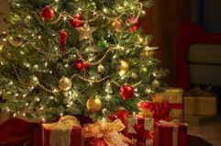
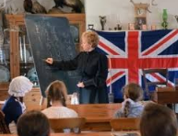
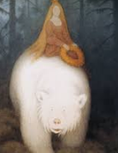
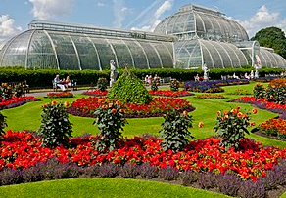
Autumn 2
Text: The Tiger who came to Tea
History: What has changed in my childhood? How was childhood the same/different in the past?
Science: Materials/Our Changing World
RE: Celebrations
DT: Moving Picture Books
Trip: Theatre trip
Spring 1
Text: Author focus; Julia Donaldson
History: What was life like over 100 years ago?
Science: Materials/Our changing world
PSCHE/RE: Belonging
Trip: Holly Lodge (History)
Autumn 1
Text: Traction Man
Geography: Where do we live?
Science: Using our senses/Our Changing World
PSCHE/RE: Self Esteem and Friendship
Trip: Our local area (Geography)
Year 1
Spring 2
Text: Jack and the Beanstalk
Geography : Where does our food come from?
Science: Animals/ Our changing world
PSCHE/RE: Keeping safe
DT: Making a fruit salad
Trip: Local Supermarket
Summer 2
Text: Grace Darling and White Bear King
History: Why do we remember Grace Darling and the Titanic?
Science: Plants/Our changing world
PSCHE/RE: Changes and SRE
DT: Model buildings
Trip: Kew Gardens (Science)
Summer 1
Text: Cloudland and Lila and the Secret of Rain
Geography : How are countries different around the world?
Science: Plants/ Our Changing World
RE: Beliefs
Trip: International Day

